Slide 1

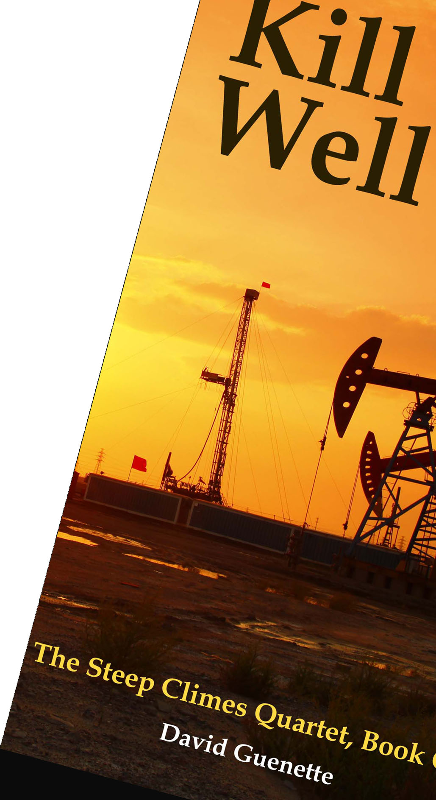

The Future of Climate Change in The Berkshires
David Guenette
Griswold Memorial Library, April 19, 2025
This presentation is through the support of Town of Colrain Cultural Council and Mass Cultural Council

Slide 2

Acknowledgments & Thanks!
Thanks to Chelsea Jordan-Makely, Library Director, Griswold Memorial Library, Colrain, MA
Promotion support for this talk has been provided by Citizens’ Climate Lobby/Berkshire Chapter and 350Mass.Org-Berkshires
Griswold Memorial Library, April 19, 2025
Notes:
Deena Caswell, Library Director
The Bushnell-Sage Library is a treasure.
New England is rich in this sort of treasure.
My advice for contributing to a better society: hang out in libraries more often!

Slide 3
About David Guenette, Part 1
Student documentary in 1970 on pollution and greenhouse gases… no, not prescient: the “Greenhouse Effect” was already well-understood
Author of The Steep Climes Quartet… started series in 2015
Background in book publishing and digital publishing
Griswold Memorial Library, April 19, 2025
Notes:
Student documentary… it isn’t that I’m prescient. It is that we’ve had greenhouse gas modeling and research for a long, long time. And, yes, Big Oil has spent a lot of time and money making sure that you don’t know. Here’s a fun fact: Much of the earliest research on greenhouse gases and global warming tied to fossil fuels was done by Exxon scientists and other Big Oil science departments in thew 1960s and 1970s.
RetroSheath came from my efforts to renovate a house in Cambridge, and later, Housatonic, to be energy efficient, well-insulated, and tight This effort, along with the building science I had to learn, combined with my work with digital technologies, including graphical processing units (CPU) and their applications; these chip sets are now in the news because of their application to AI.
I’ll talk about The Steep Climes Quartet and the books in the series throughout, as part of the presentation on the future of climate in the Berkshires, when there is a relevant point to make, but the next couple of slides describe what the series is and what I’m hoping to accomplish with the series. .

Slide 4
About David Guenette, Part 2
Climate change autodidact since 2007, climate blogger
Founded RetroSheath, a D.E.R. start-up
Resident of Berkshires for two decades
Member of Citizens’ Climate Lobby (CCL) and 350Mass.Org-Berkshires
Griswold Memorial Library, April 19, 2025
Notes:
Student documentary… it isn’t that I’m prescient. It is that we’ve had greenhouse gas modeling and research for a long, long time. And, yes, Big Oil has spent a lot of time and money making sure that you don’t know. Here’s a fun fact: Much of the earliest research on greenhouse gases and global warming tied to fossil fuels was done by Exxon scientists and other Big Oil science departments in thew 1960s and 1970s.
RetroSheath came from my efforts to renovate a house in Cambridge, and later, Housatonic, to be energy efficient, well-insulated, and tight This effort, along with the building science I had to learn, combined with my work with digital technologies, including graphical processing units (CPU) and their applications; these chip sets are now in the news because of their application to AI.
I’ll talk about The Steep Climes Quartet and the books in the series throughout, as part of the presentation on the future of climate in the Berkshires, when there is a relevant point to make, but the next couple of slides describe what the series is and what I’m hoping to accomplish with the series. .

Slide 5
About The Steep Climes Quartet
Literary climate fiction thriller series that follows several Berkshire residents through the effects of climate change across the span of nearly three decades
Griswold Memorial Library, April 19, 2025
Notes:
For those who believe climate fiction is only apocalyptic floods or a world turned into desert with armed gangs fighting over water or fuel or some other stark dystopia, you’ll be disappointed in The Steep Climes Quartet.
Although climate apocalypse is possible, it is hardly probable, especially looking at the Berkshires or pre-2100 A.D., although I’d advise against purchasing beachfront property for the long term.
The series follows several Berkshire residents through the effects of climate change across the span of nearly three decades, and it is not Mad Max, but it is a time of growing costs, expanding unpleasant weather events, sustained societal struggle, and ever more crucially citizen responsibility.
Most of what we experience of climate change is in the news, in the background, and in political battles. And, of course, Big Oil’s ongoing efforts to confuse people about climate change.
How do I know this? Because we see all these developments in our daily lives already. Science tells us our current conditions will continue to worsen. When it comes to the human race, it is an easy enough bet that we’ll take a lot of time to comes to terms with the challenges in front of us and the implementing solutions will be clumsy and imbued with conflict.

Slide 6
The Steep Climes Quartet Timeline
Kill Well, published in Fall 2023, begins in 2026
Dear Josephine, publishing Spring 2025, takes place in 2029
Over Brooklyn Hills takes place in 2035
Farm to Me takes place in 2047
Griswold Memorial Library, April 19, 2025
Notes:
A quick overview of The Steep Climes Quartet.
Literary climate fiction thriller series that follows several Berkshire residents through the effects of climate change across the span of nearly three decades
Kill Well, published in Fall 2023, begins in 2026
Dear Josephine, publishing Spring 2024, takes place in 2029
Over Brooklyn Hills takes place in 2035
Farm to Me takes place in 2047

Slide 7
THE STEEP CLIMES QUARTET THEMES AND CHARACTERISTICS
Our fractured society and the solidarity of action climate progress requires
Reader identifies with deeply drawn characters’ near- and mid-term futures
Climate change science, technologies, and politics are grounded in long- term and in-depth study
Griswold Memorial Library, April 19, 2025
Notes:
The most important note in my long-term and in-depth study of climate change is that the science and understanding of climate change remains fluid, and since I’m neither omniscient nor clairvoyant, the best I can do is write reasonable scenarios across the series.
Not only did I have to learn about climate change, but I had to apply this understanding across almost three decades represented within the series.
One item of confidence I hold is that man’s greenhouse gas contributions over the last hundred-plus years is contributing to global warming, just like what the largest consensus of scientists conclude.

Slide 8
POLITICS IN AMERICA… AND THE NEED TO PAUSE
Instead of sticking with my earlier assumptions about politics in America’s near future, the final manuscript revisions for Dear Josephine waited on November 2024 elections.
A revision of Kill Well was also made, and for the same reason—the major shift in Federal climate policies to more accurately reflect what is happening politically today.
Griswold Memorial Library, April 19, 2025
Notes:
Well, I decided to leave this slide in, because it reenforces a big theme of the series, which is that politics matters for climate progress. The slide was first added post-Biden/Trump debate that held my attention for the several weeks that followed.
If Trump were to win the 2024 election, the books in the series—and especially the first two books, taking place in 2026 and 2029, respectively—would have to slant much darker and require, therefore, revision (and, for Kill Well, a new edition).
I’m starting to calm down now that the election circumstances have shifted with Harris the nominee, but I’ll probably stick with the November pause.
It is important for the first books—as near-future—are seen by readers as reflecting as realistically as possible the world of the reader.

Slide 9
THE STEEP CLIMES QUARTET’S GOAL #1
Entertain while informing the reader of the probable future of climate change for the Berkshires—and by extension—the world
Griswold Memorial Library, April 19, 2025
Notes:
Entertain while informing the probable future of climate change for the Berkshires—and, by extension—the world

Slide 10
THE STEEP CLIMES QUARTET’S GOAL #2
Explore characters’ challenges with climate change and how climate change’s consequences affect the characters’ lives and elicit positive and negative reactions
Griswold Memorial Library, April 19, 2025
Notes:
As the series progresses, there’s more about how some of the characters get involved in local, state, and national politics as a means of making progress
with climate change
As the series progresses, I’ll be focusing more on how getting involved in local, state, and national politics is an important means of making progress
with climate change

Slide 11
THE FUTURE OF CLIMATE CHANGE IN THE BERKSHIRES… STARTING WITH THE PRESENT
2023: Hot, Smoky, Deluges
2024: Hotter yet (both climate and politics)
Griswold Memorial Library, April 19, 2025
Notes:
Starting with the present is a great place to start,.

Slide 12
POLITICS IS CRUCIAL…
Today, there is a climate change denier in the White House, an ongoing Constitutional crisis, and Federal climate progress efforts under assault nationally.
The main driver for climate progress is legislative: the right laws, regulations, tax policies supporting the transition to renewable energy
Griswold Memorial Library, April 19, 2025
Notes:
Climate change is mostly not on a human scale—not today’s immediate or biggest problem in most anybody's’ life (at least here in the developed world)—unless, of course, you find yourself in the middle of a deluge, or massive storm, or choking on smoke, or dealing with a life- or health-threatening heat alert.
There are huge advantages in a clean energy transition even apart from contributing to climate progress.

Slide 13
THE CLEAN ENERGY TRANSITION IS CRUCIAL, REGARDLESS OF CLIMATE CHANGE
Fossil fuel use is responsible for an estimated 5.13 million additional deaths per year globally due to air pollution.
7,500 excess deaths, 410,000 asthma attacks, and 2,200 new cases of childhood asthma in the U.S. are tied to fossil fuel pollution
Griswold Memorial Library, April 19, 2025
Notes:
November 2023 BMJ article
Environmental Research: Health study findings from show that the pollutants nitrogen oxide , fine particulate matter (PM2.5) and ozone (O3) from U.S. oil and gas production contributed to 7,500 excess deaths, 410,000 asthma attacks, and 2,200 new cases of childhood asthma across the U.S. in 2016.

Slide 14
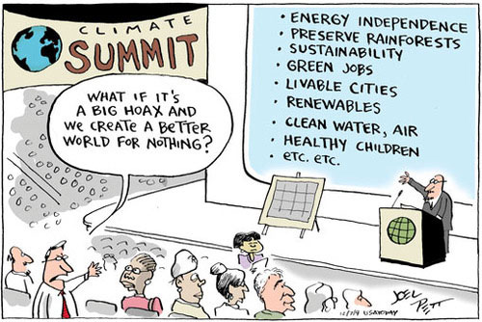
Bushnell-Sage Library, August 10, 2024
Notes:
Joel W. Pett is an American Pulitzer Prize-winning editorial cartoonist that formerly worked for the Lexington Herald-Leader. His cartoons are syndicated by Tribune Content Agency.

Slide 15
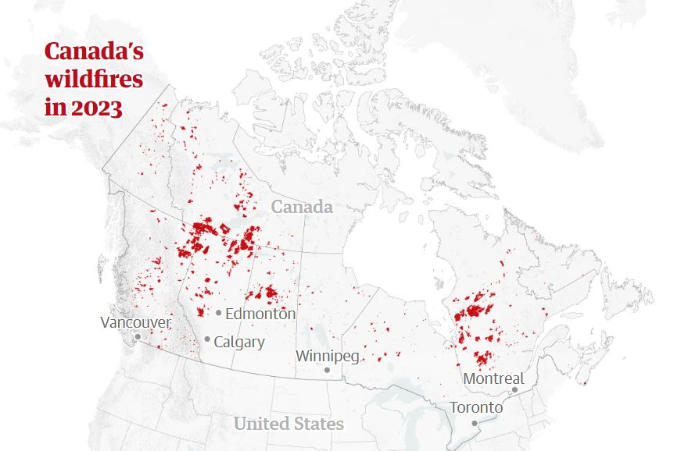
2023: MULTIPLE DAYS IN THE NORTHEAST OF CHOKING SMOKE FROM CANADIAN WILDFIRES THAT BURNED 47 MILLION ACRES
Griswold Memorial Library, April 19, 2025
Notes:
BUT it is not for nothing.
We all remember the days and days last year when going outside was ill-advised, with the smoke from massive Eastern Canada’s wildfires casting a pall over us, literally. The jump in the number and scope of wildfires across the world have added O2, but some scientists believe the pervasive and widespread smoke and particulates from the fires may have helped keep global warming down very slightly. Climate systems are extremely complex and difficult to accurately factor.
47 million acres is about the size of ND
In Kill Well, as the character Cynthia, or Cyn, is fleeing her boss’s murder in San Bernadino County (near Mojave), she finds herself checking whether the bus route to Vegas will take her through one of the wildfire zones. Like 2023 and many previous recent years, wildfires are in the news.

Slide 16
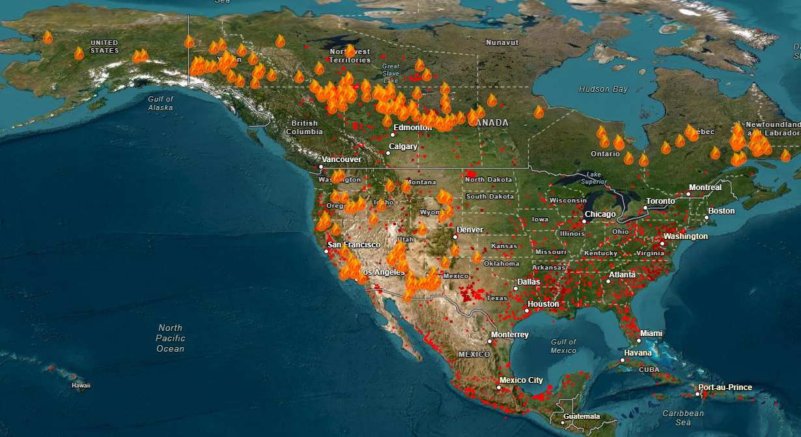
2024 WILDFIRES MAP FOR JULY 17, US AND CANADA
Griswold Memorial Library, April 19, 2025
Notes:
You know, I know, we all know that there are wildfires every year, and ever thus.
The difference global warming makes is bigger, longer wildfire seasons. In some areas of the world, it is open season for wildfires year-round.

Slide 17
2024 WAS THE HOTTEST YEAR IN
THE PAST NINE YEARS…
…and each of these years are among the hottest on record
Griswold Memorial Library, April 19, 2025
Notes:
A snapshot for 2023, with darker red areas showing where temperature for the year is above average.
That is a lot of red.

Slide 18
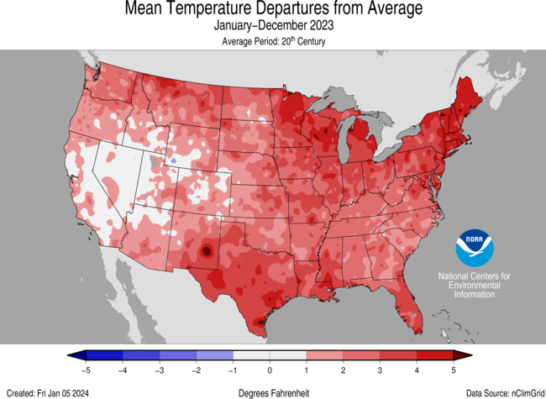
Griswold Memorial Library, April 19, 2025
Notes:
A snapshot for 2023, with darker red areas showing where temperature for the year is above average.
That is a lot of red.

Slide 19
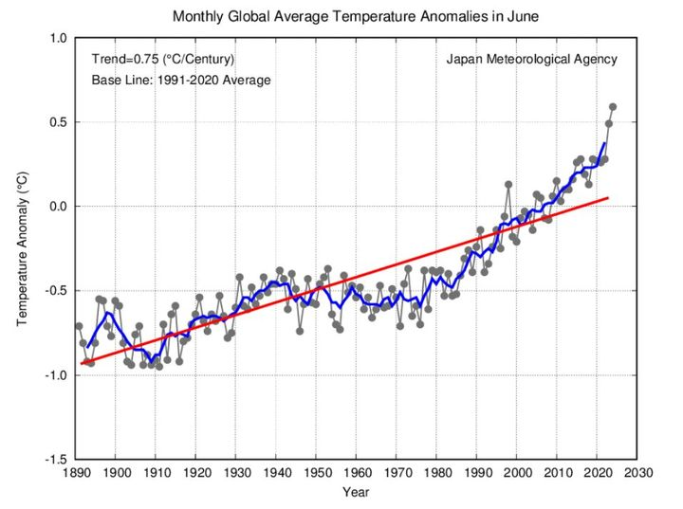
HEAT TRENDS, 1800-2030
Griswold Memorial Library, April 19, 2025
Notes:
This is a tough slide that shows the trend toward warmer world temperatures.
We are heading to 1.5 degrees C, and if we don’t meet Paris Agreement decarbonization targets, we’re going past 1.5 degrees C.
Few scientists—or Secretary General of the United Nations—think we’re going to meet the Paris agreement.
What’s wrong with the world getting a little warmer? The difference between annualized average temperature and what actually happens with any particular day, where spikes of temperature can kill people and decimate species, reduce crops, support more destructive weather, to name a few.
It’s a hot time in the old town tonight.

Slide 20
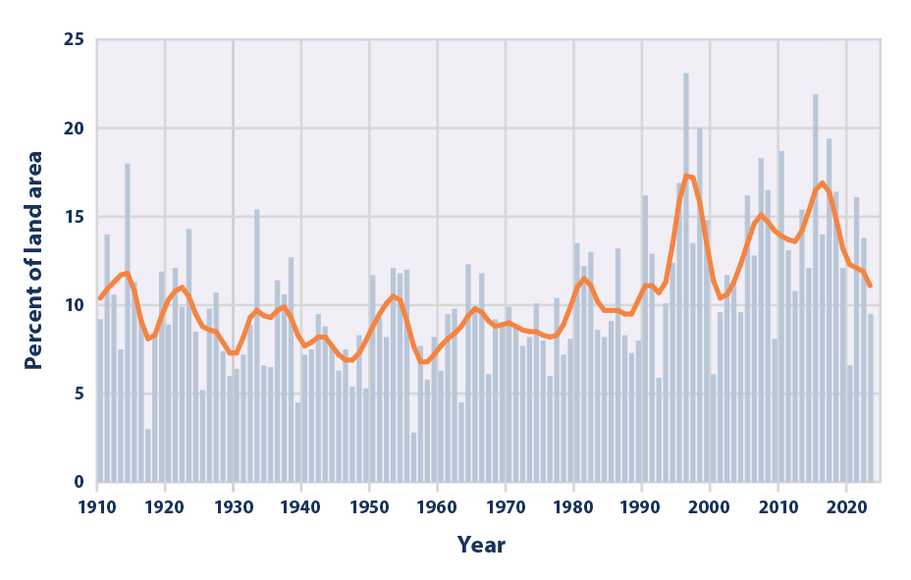
HEAVY PRECIPITATION EVENTS TREND 1800-2030
Bushnell-Sage Library, August 10, 2024
Notes:
The variability of precipitation across any year is large, and between years, too. Unfortunately, the trend is clear and matches what the world growing warming will behave. More heat, more moisture held in the air… but what goes up must come down, so, tut, tut, it looks like rain.

Slide 21
2023: DELUGES KILLING PEOPLE AND DESTROYING PROPERTY IN VERMONT, NEW YORK, AND MASSACHUSETTS
Extreme heat was the deadliest weather condition in the United States in 2023, resulting in a total of 207 lives lost that year. This was followed by fire weather, having caused 103 fatalities.
Griswold Memorial Library, April 19, 2025
Notes:
Last year there were several unusually heavy rain deluges in the Northeast, including Vermont, New York, and Massachusetts. Heavy deluges are expected to increase in frequency in the Northeast.
Leominster, MA received 10 or 11 inches of rain over a six hour period, causing huge destruction.

Slide 22
THESE ARE 10 OF THE DEADLIEST NATURAL DISASTERS IN 2024, PART 1
1. Tropical Storm Trami Claims More Than 100 Lives in the Philippines
2. Wildfires Kill at Least 136 in Chile
3. Flooding and Landslides Kill at Least 192 in Nepal
4. New Year’s Earthquake Claims at Least 213 Lives in Japan
5. Heavy Flooding Kills at Least 224 in Spain
6. Hurricane Helene Kills At Least 225 in the Southeastern U.S.
Griswold Memorial Library, April 19, 2025
Notes:
Last year there were several unusually heavy rain deluges in the Northeast, including Vermont, New York, and Massachusetts. Heavy deluges are expected to increase in frequency in the Northeast.
Leominster, MA received 10 or 11 inches of rain over a six hour period, causing huge destruction.

Slide 23
THESE ARE 10 OF THE DEADLIEST NATURAL DISASTERS IN 2024, PART 2
7. Landslides Claim at Least 250 Lives in Ethiopia
8. Typhoon Yagi Kills Nearly More Than 500 Across Several Southeast Asian Countries
9. Landslide Claims at Least 670 Lives in Papua New Guinea
10. Heat Wave Kills at Least 1,300 During Hajj Pilgrimage in Saudi Arabia
U.S. World & World Report, December 27, 2024
Griswold Memorial Library, April 19, 2025
Notes:
Last year there were several unusually heavy rain deluges in the Northeast, including Vermont, New York, and Massachusetts. Heavy deluges are expected to increase in frequency in the Northeast.
Leominster, MA received 10 or 11 inches of rain over a six hour period, causing huge destruction.

Slide 24
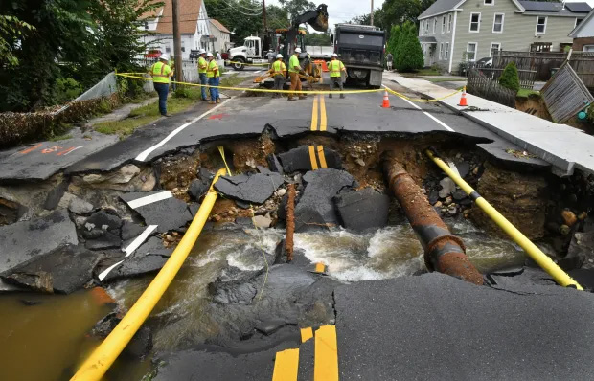
2023: DELUGES KILLING PEOPLE AND DESTROYING PROPERTY IN VERMONT, NEW YORK, AND MASSACHUSETTS
Griswold Memorial Library, April 19, 2025
Notes:
Last year there were several unusually heavy rain deluges in the Northeast, including Vermont, New York, and Massachusetts. Heavy deluges are expected to increase in frequency in the Northeast.
Leominster, MA received 10 or 11 inches of rain over a six hour period, causing huge destruction.

Slide 25
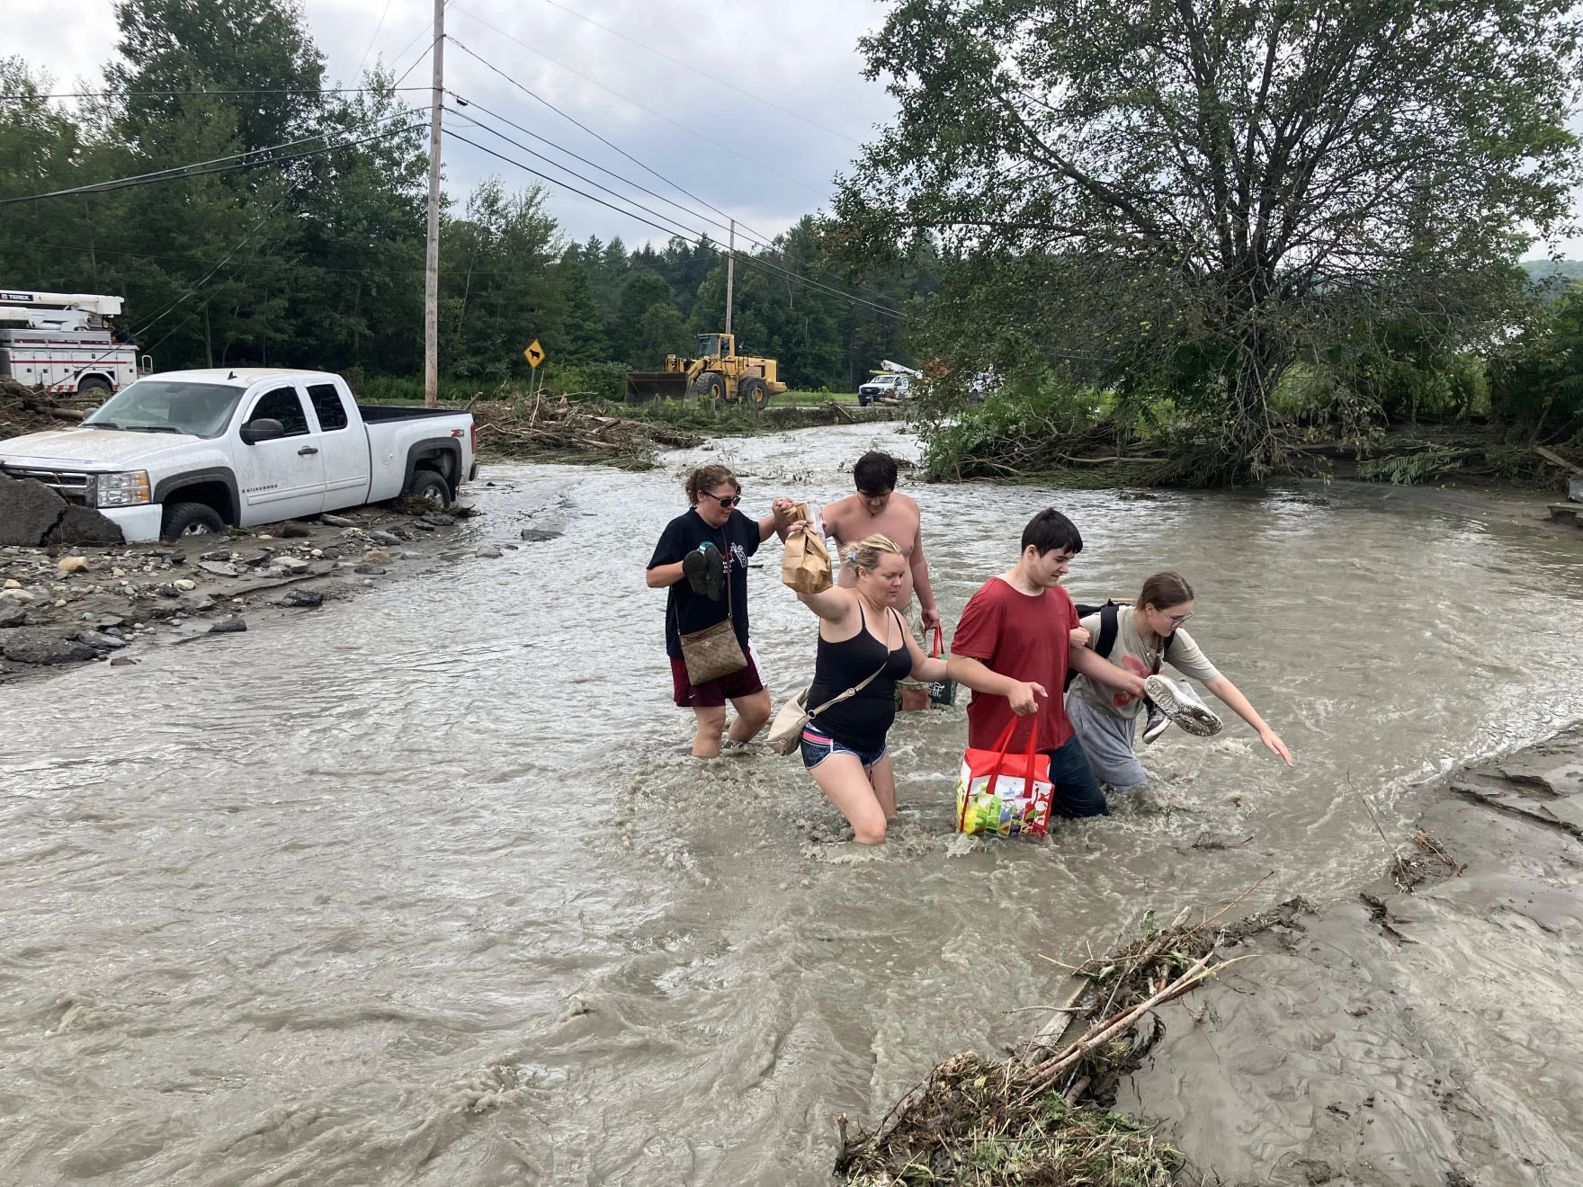
AND VERMONT IN 2024…
Griswold Memorial Library, April 19, 2025
Notes:
From Vermont Public (News) by Peter Hirschfeld, Published July 30, 2024 : Flash flooding in far-flung pockets of the Northeast Kingdom has destroyed houses, stranded homeowners and left longtime residents of rural communities on edge after experiencing their fifth catastrophic rain event in less than 13 months.

Slide 26
WHAT SCIENCE KNOWS AND DOESN’T KNOW ABOUT ATTRIBUTING CLIMATE CHANGE AND EXTREME WEATHER, PART 1
From the science perspective, we can’t confidently relate specific weather events to climate change
Climate is determined by long-term statistical analysis
Griswold Memorial Library, April 19, 2025
Notes:
Extreme weather events may reflect changes in the climate, but any specific weather event can’t be definitively said to be caused by climate change.
.
Climate reflects the average weather events over a 30-year period, minimally, which is updated every ten years. The most recent climate period is 1991-2020. The difference between each successive 30-year climate period serves as a very literal record of climate change.
This way of thinking about the climate falls short when the climate itself is rapidly changing. Global average temperatures have increased at around 0.2°C per decade over the past 30 years, meaning that the global climate of 1991 was around 0.6°C cooler than that in 2020 (when accounting for other year-to-year fluctuations), and even more so than the present day.
https://theconversation.com/the-climate-is-changing-so-fast-that-we-havent-seen-how-bad-extreme-weather-could-get-235726

Slide 27
WHAT SCIENCE KNOWS AND DOESN’T KNOW ABOUT ATTRIBUTING CLIMATE CHANGE AND EXTREME WEATHER, PART 2
Weather varies moment to moment
Climate is determined by trends in weather variations over time— decades and centuries
Griswold Memorial Library, April 19, 2025
Notes:
Extreme weather events may reflect changes in the climate, but any specific weather event can’t be definitively said to be caused by climate change.
.
Climate reflects the average weather events over a 30-year period, minimally, which is updated every ten years. The most recent climate period is 1991-2020. The difference between each successive 30-year climate period serves as a very literal record of climate change.
This way of thinking about the climate falls short when the climate itself is rapidly changing. Global average temperatures have increased at around 0.2°C per decade over the past 30 years, meaning that the global climate of 1991 was around 0.6°C cooler than that in 2020 (when accounting for other year-to-year fluctuations), and even more so than the present day.
https://theconversation.com/the-climate-is-changing-so-fast-that-we-havent-seen-how-bad-extreme-weather-could-get-235726

Slide 28
WHAT SCIENCE KNOWS AND DOESN’T KNOW ABOUT ATTRIBUTING CLIMATE CHANGE AND EXTREME WEATHER, PART 3
Opponents of climate change (including “deniers”) cite the limits on scientific conclusions on causality without large enough data sets
Weather events aren’t scientific proof, but the commonsense connections makes climate sense
Griswold Memorial Library, April 19, 2025
Notes:
Extreme weather events may reflect changes in the climate, but any specific weather event can’t be definitively said to be caused by climate change.
.
Climate reflects the average weather events over a 30-year period, minimally, which is updated every ten years. The most recent climate period is 1991-2020. The difference between each successive 30-year climate period serves as a very literal record of climate change.
This way of thinking about the climate falls short when the climate itself is rapidly changing. Global average temperatures have increased at around 0.2°C per decade over the past 30 years, meaning that the global climate of 1991 was around 0.6°C cooler than that in 2020 (when accounting for other year-to-year fluctuations), and even more so than the present day.
https://theconversation.com/the-climate-is-changing-so-fast-that-we-havent-seen-how-bad-extreme-weather-could-get-235726

Slide 29
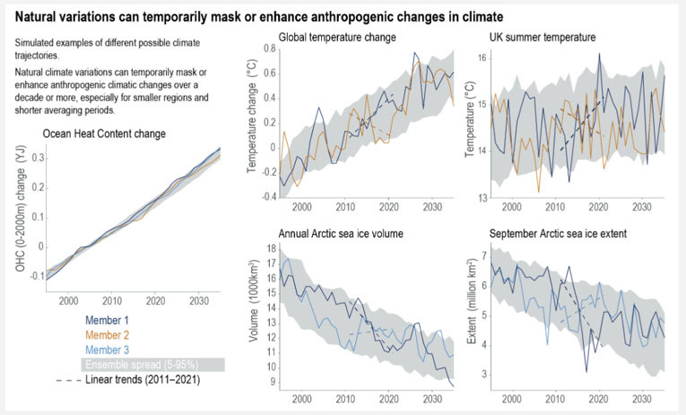
Notes:
We can’t connect specific weather to climate change, but the data shows trends.
This set of charts is from the Intergovernmental Panel on Climate Change (IPPC) [https://www.ipcc.ch/report/ar6/wg1/chapter/chapter-1/] and shows 30-year period of weather data and extrapolating climate trends.
The squiggly lines are records of weather, including Ocean Heat content change; Global temperature change; UK summer temperature; Annual Artic sea ice volume; and September Artic sea ice extent.
Data points are variable, but the grey averaging in all these charts over a 30-year period strongly suggests changes in climate, even while variability remains wide (except for ocean temperature where variability is muted).
There is about 150 years’ worth of good weather data…

Slide 30
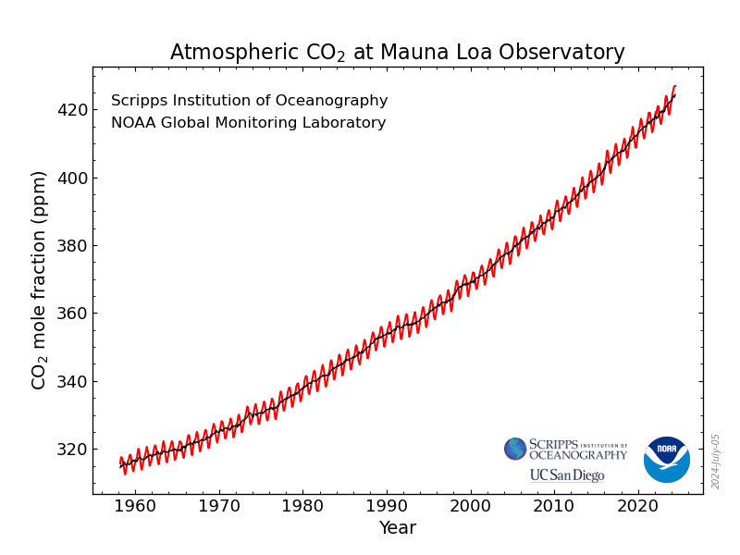
Notes:
Here’s another blown up as big as I can chart, this one about CO2 in the atmosphere.
There have been high quality measurements of CO2 PPM (parts per million) in the atmosphere since 1958, and the rise is dramatic.
Greenhouse gases (of which CO2 is the largest type, but methane, another GHG, has also risen and is far more potent as GHG) trap heat… and thus global warming.
Yes, the science is more complicated, but this basic greenhouse effect is beyond argument.

Slide 31
GREENHOUSE GAS PROGRESS? PART 1
NOAA data and models help scientists track the global carbon cycle and greenhouse gas emissions from fossil fuels and these are projected to reach a record 36.8 billion metric tons in 2023, an increase of 1.1% over 2022
Griswold Memorial Library, April 19, 2025
Notes:
In 2023, the world added another 36.8 billion metric tons of GHG from fossil fuels, a percentage point or so higher than the previous year, and then there are all the other previous years.
China currently gets ~ two-thirds of its electricity from coal; India is closer to three-quarters.
Fossil fuels dump a lot of GHG into the atmosphere.
There are other sources of GHG, including industrial processes (making cement, for example) and agriculture.

Slide 32
GREENHOUSE GAS PROGRESS? PART 2
Declining coal use helped shrink U.S. greenhouse gas emissions 3%, according to new estimates from the Global Carbon Project, even as global emissions keep the world on a path to exceed 1.5⁰ Celsius of warming before 2030 and 1.7⁰ degrees soon after
Griswold Memorial Library, April 19, 2025
Notes:
A little bit of progress on GHG emission reduction is better than no progress, and in the U.S., we’ve had some modest success.

Slide 33
PROGRESS IS POSSIBLE
In 2021, the Infrastructure and Jobs Act passed, containing many big budget items to help fight climate change
In 2022, The Inflation Reduction Act passed, representing the most significant budget and sets of programs so far to address climate change
Griswold Memorial Library, April 19, 2025
Notes:
We’ve had some significant success in climate progress legislation, with the hope that U.S. GHG emissions will continue to fall and at an ever-accelerating pace.

Slide 34
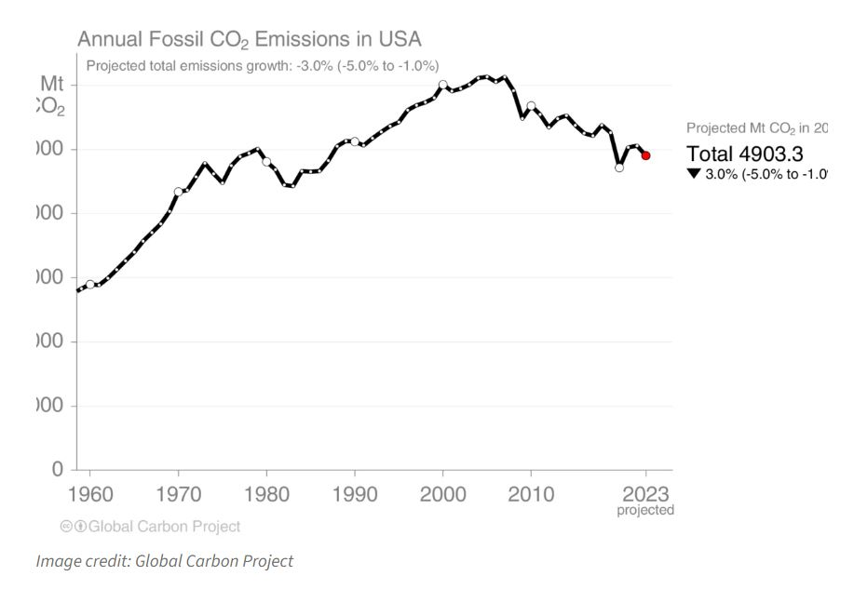
THE PRESENT DAY... GHG PROGRESS IN U.S.
Griswold Memorial Library, April 19, 2025
Notes:
Modest success in the U.S., as far as CO2 is concerned, but this trend has to speed up.
The relatively large reduction toward the right side of the graph is COVID, and we’ve bumped back up since the economic slowdown the pandemic caused, but the trend remains in the right direction.

Slide 35
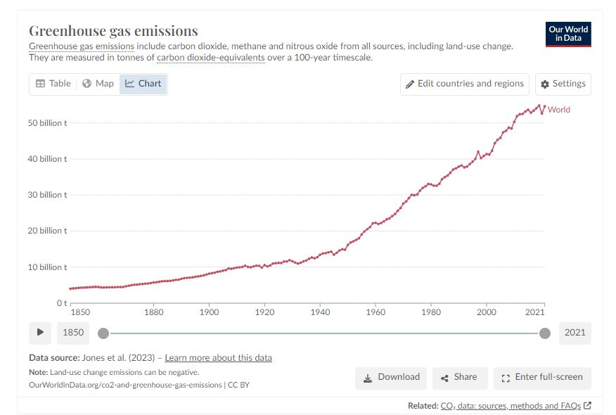
THE PRESENT DAY... GHG STILL GROWING WORLDWIDE
Griswold Memorial Library, April 19, 2025
Notes:
While some GHG emissions reductions have been accomplished in some places, there are other countries still increasing their GHG emission, including China, India, and most other parts of the developing nations.

Slide 36
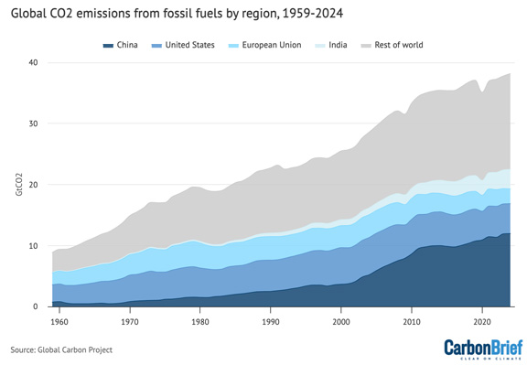
THE PRESENT DAY... GHG STILL GROWING WORLDWIDE
Griswold Memorial Library, April 19, 2025
Notes:
While some GHG emissions reductions have been accomplished in some places, there are other countries still increasing their GHG emission, including China, India, and most other parts of the developing nations.

Slide 37
IMAGINING THE BERKSHIRE CLIMATE FUTURE: WEATHER
Storms, rain, floods, fires, heat… a lot like 2023 and 2024
Most days will still seem normal, but there will be more destructive weather, and it will keep getting worse, and this has economic and social consequences
As the decades pass, more frequent extreme weather events occur
Griswold Memorial Library, April 19, 2025
Notes:
Well, this doesn’t take imagining, since you can just remember. 2023 was the hottest year (worldwide average temperature) and 2024 is just a bit cooler.
The fact is that we can’t say this particular rainstorm is because of climate change, or that specific record hot day is, either, and it is likely that the weather here will be much as it always is, except there will be increasingly more frequent instances of hot days, big rainstorms, mild winters…
While there is the potential for catastrophic shift in our weather—if, for example, the Atlantic meridional overturning circulation (AMOC) or Gulf Stream slows or stops, or a major collapse of Antarctic ice shelf, or a handful of other inflection points such as permafrost thaw and/or methane clathrate releasing huge amounts of methane—changes in weather are likely to be gradual, but with increasing numbers of catastrophic weather incidents.
Of course, it won’t feel gradual if you have a house near a stream or river and there’s a huge deluge, for instance.
These days, when I’m driving around, I notice vulnerable houses and buildings near streams and rivers. Uh oh, I think, considering the prospects for 10 inches of rain in 6 hours… or worse.

Slide 38
IMAGINING THE BERKSHIRE CLIMATE FUTURE: AGRICULTURE
Climate change will drive domestic and imported food production areas toward reduced yields, raising costs and food supply problems and causing unrest and conflict
There may be local agricultural opportunities and growth in New England farming
Griswold Memorial Library, April 19, 2025
Notes:
What happens when the weather gets hotter, or droughts longer, or new crop diseases or blights move north?
Major agricultural area in the West and Southwest have been trending dry and once-productive farmland may become less productive, and, of course, food prices go up.
Crucial aquafers are dropping to dangerously low levels. There’s a great climate fiction novel by Paolo Bacigalupi titled The Water Knife” all about this topic.
Bad weather is nothing new to farmers, and weather has always been able to make or break a growing season. As time goes on and GHG persist and increase, such make or break weather increases.
America is a developed country with lots of resources, including farm programs and a record of strong yields. There are other countries lacking resources and food production resiliency, and food—especially staples like grain—are commodities and are subject to some extent to supply and demand price pressure.
Food is going to grow more expensive.
Of course, with market stresses opportunities can arise. New England was a major agricultural economy once, and warmer weather trends and rarity of drought could see agriculture expand in the Northeast if other food production areas suffer chronically lower yields.
Of course, weather is uncertain under the best of circumstances, and in global warming, ever more unpredictable.
Climate change is expensive, and one price we’re likely to see go up is food.

Slide 39
IMAGINING THE BERKSHIRE CLIMATE FUTURE: ECONOMY
Costs rise as infrastructure repair from extreme weather events put pressure on taxes, along with new climate change mitigation projects
Climate change will present increases in costs for insurance, food, energy, and healthcare, taxes, construction, putting more pressure on a household’s budget
Griswold Memorial Library, April 19, 2025
Notes:
We’ve seen food prices jump, and currently this is due to market forces, including corporate food production and distribution consolidation and the pricing freedom monopolies and enormous market aggregators can indulge.
But as mentioned earlier, food is also a supply and demand situation, and so supply can be threatened with production areas facing growing weather threats as the decades move forward.
People think of climate change problems as weather problems, but there are many follow-on consequences for the economy, too. More storm damages? More infrastructure repair and mitigation and resiliency projects required, so consider the likelihood of higher taxes, local, state, and federal. We are already underspending on infrastructure, as any of us who have to redirect because of bad bridges in Berkshire County can attest.
Personal household spending will see not only higher food costs and higher taxes, but also higher repair and maintenance costs—downed trees, roof repairs, water in the house mitigation, power outages, and if you don’t think this is likely, just look at your property insurance costs, already rising and projected to increase more and more. There are states—CA and FL are the current leading examples—where insurance companied are or already have fled the states because payouts have grown, while premiums become unaffordable. It turns out that insurance companies like it better when they take in more money than they pay out in claims.
Energy costs—aren’t energy costs supposed to drop because renewable energy is now, in most places, the cheapest source of electricity? Well, there is a lot of building out non-fossil fuel energy production (solar farms, windmills, geothermal, nuclear) and a lot of building of higher capacity in electricity transmission infrastructure, and in batteries to offset the intermittency of the main renewables. Power will get cheaper, but there are decades of effort still before us and power companies don’t build out capacity and transmission infrastructure for free. The energy transition from fossil fuels to renewables and other forms of clean energy is a long-term affair that will be messy, clumsy, and expensive.
The good news here is that this expense is far lower, long term, then the cost of doing too little. When climate change is described as existential, no on sensible is saying climate change will kill you or me anytime soon, unless, of course, we are among the unlucky in circumstance, but that human culture is complex and fragile and not addressing climate change effectively will, sooner or later, lead to society’s collapse. We’re seeing small examples (these are not small to those experiencing the effects, of course), in regions beset by drought an/heat or conflict caused by food production and other economic collapse in the form of climate migrants.
But, of course, if you happen to be standing in the wrong place when a massive downpour occurs and you get swept away, well that’s existential for you. Disease is another type of personal and societal existential threat made more likely with climate change. Dengue fever in New England, or West Nile Virus or Zika or malaria? How about tick-bourne disease vectors growing, and mainly because we less frequently experience really old winters of the sort with long periods of hard freeze that kills off ticks trying to overwinter.
Outdoor work—construction, farming, recreation—will suffer and have higher cost , with growing numbers of days when it is too high a heat index. Chronic kidney diseases and higher death rates among Nicaraguan sugar cane workers is tied to heat stress in a recent study.

Slide 40
IMAGINING THE BERKSHIRE CLIMATE FUTURE, TOURISM
A significant part of the Berkshires economy is tourism
Visitors to the Berkshires—and their economic impact—may decline over the decades as too many hot days make Tanglewood and other cultural institutions less of a draw, and warm winters suppress winter sports businesses
Griswold Memorial Library, April 19, 2025
Notes:
Tourism accounts for a lot of the Berkshire County economy, from 7.25 percent relative to the county’s GDP, or much more if you include carry-over goods and services that tourists and visitors contribute to the economy that may not be specifically identified as “tourism.”
Tanglewood, the summer home the Boston Symphony Orchestra, is the largest single cultural intuition attraction but is just one of many that rely on outdoor activities in part or in whole.
Will more extreme heat days reduce visitor numbers? Tanglewood and other outside venues might have to cancel performances due to dangerous temperatures. We saw this in 2023.
Outdoor attractions like hiking and biking too may be less attractive on more days, and outdoor dining is likely to retreat as the temperature gets too high.
Climate change consequence applies to winter tourism, too, and already, less snow coverage and warmer temperatures in the winter is taking business from ski resorts.
On the other hand, the cost of long-range travel (e.g., airplanes) may shift vacation plans to more local spots, and maybe climate change will further boost tourism from other areas, or it may be that rising costs generally reduce the number of people who takes vacations or trips.

Slide 41
KILL WELL: 2026
Massive heat wave in upper Midwest, including Chicago, sending Jimmy, Davin’s son, back to Housatonic
Wildfires in Western U.S.
Huge rainstorm wrecks Davin’s garden, damages home
Trump opposes Federal climate progress actions and fossil fuel special interests are on the march
Griswold Memorial Library, April 19, 2025
Notes:
Kill Well takes place in 2026—just around the corner.
There are people working toward climate progress, like Cynthia, a young fossil fuel activist divestiture working for a non-profit. She experiences the effects of wildfires as she flees from someone who wants her dead,
She meets Jimmy, the main character Davin‘s son, on the train when they are Pittsfield-bound, as Jimmy leaves his post-college Chicago apartment in the middle of a dangerous, long-lasting heatware, and he’s heading home to dad in Housatonic, where the weather is better.
Davin, with the foolish hope that only a gardener posses, sees his big vegetable garden wrecked by a big deluge that also causes some house damage.
In other words, nothing too weird.

Slide 42
DEAR JOSEPHINE: 2029
Unprecedented hurricane destroys Florida’s Gold Coast
Heatwaves in the Global South are increasing climate migration
Floods in central Massachusetts put pressure on the local economy and Davin still struggles
National politics shift toward Democrats, but climate terrorism grows
Griswold Memorial Library, April 19, 2025
Notes:
Dear Josephine takes place in 2029 and the biggest weather event is an uncategorizable hurricane—named Josephine—early in the season wrecks Florida’s Gold Coast, with a couple of million displaced residence from Miami and environs.
The storm re-invigorates interest in the proposed Sea Wall Act.
Heatwaves in the Global South are resulting in big climate immigration, especially in Europe and at our southern border.
The town of Palmer, toward the close of the book, suffers from a high-volume rain event and sees damage and a few dead.
Nothing in these weather events is exaggerated and all are well within the plausible.

Slide 43
OVER BROOKLYN HILLS: 2035
Increasing heatwaves drive some from NYC to “free camp” in the Berkshires causing local conflict and Davin’s caught in the middle
Chronic Western drought hurts food production and food prices spike
Climate drives U.S. single-issue voting but climate despair drives violence, including against climate migrants
Technology and AI drop more people into lower economic classes
Griswold Memorial Library, April 19, 2025
Notes:
Over Brooklyn Hills takes place in 2035 and may be my favorite story line (although that may be because I’m writing it now), sees the Berkshires troubled by growing numbers of poor young urbanites who flee NYC because of the heat… and because they can’t don’t have air conditioning or can’t afford the energy costs to run air conditioning.
It’s been really interesting—well, to me, anyway—to imagine what a Great Barrington Select Board meeting about vagrants might be like. I’m pretty sure some citizens will talk about border checks, but certainly most will be unhappy with the spike in petty crimes and the proliferation of the “unwashed” that strain the local economy. Will these folk be camping in the woods behind your house?
Some of America’s biggest food production areas are suffering from multi-year droughts that reduce crop yield, or worse, and the price of an avocado has never been higher, and who can afford almonds anymore? Well, on the other hand, more people are growing kitchen gardens and more and more truck farms reappear and expand after so many decades gone.
The U.S. military is deployed to the southern border and there is political instability in several European nations, all due to big increases in Global South climate migration.
China has become belligerently anti-climate because their economy has been suffering from a big recession, and there is now more than the usual amount of talk of war.

Slide 44
FARM TO ME: 2049
Heatwaves, droughts, hard rains have raised food prices and Northeast farms supply much of the Northeast
Global South climate migration leads to more armed international conflicts
The clean energy transition advances and becomes the focal point of Global South development by China and the U.S.
Davin tries to solve a local murder
Griswold Memorial Library, April 19, 2025
Notes:
Farm to Me takes place in 2049 and food prices are even higher, but Northeast farms are cashing in with ever-expanding farms to supply the market demand.
There has been a lot of progress with climate change efforts, but the world still is falling badly short of the 1.5 degrees C target, and now hopes to keep it under 2.5 degrees C.
The instability of the Antarctic Ice Shelf is adding new motivation, as is the slowdown of AMOC, which puts England and a few other northern latitude European countries in the cold.
U.S. is involved militarily with some of its NATO partners as political and instability turns to armed conflict that engulfs the Mediterranean theatre of operations.
On the other hand, the Global South is finally getting real action on COP Loss & Damage pledges, and China, a reinvigorated clean energy giant, is in an economic competition with the U.S. to build out clean energy in the Global South through Loss & Damage contract fulfillments.
Methane, now largely curbed from the fossil fuel industry, is threatening hopes for climate stability due to permafrost release and methane clathrates from the ever-warmer geosphere of sedimentary structures and forms.

Slide 45
POLITICS AND SOCIETY
As climate worsens, do we, as a community, a state, a country get better or worse?
1. Social discord: collapse or not?
2. Climate migration: welcome or not?
3. Nation state: war or peace?
4. Income/resource inequality: share or hoard?
Griswold Memorial Library, April 19, 2025
Notes:
Even today, when climate change for most of us seems an item only in the news and not in our day-to-day lives, politics and society is a mess, and the 2024 elections look like just another example of how divided the country is.
If economic strains get bad enough—a long heatwave crashes the grid, or homeowners with lapsed insurance are hit by bad storms, or food prices stress too many families’ resources—how will we behave?
There are those who claim that climate change is already out of control and that there’s nothing to do about it. I castigate these “doomers” and wonder at the seeming comfort in such self-fulfilling thinking.
If a critical number of our fellow citizens to give up, how fast might widespread collapse happen? I, for one, would rather not find out.
An even bigger problem is in how we choose to handle the much larger numbers of climate migrants. Already we see millions at our southern border and many of these are economic migrants who are leaving agricultural areas in Central and South American because of chronic drought and farm failure., and this number is only growing. Do we build that wall or send troops to the border, or do we take climate change into account as we work on new immigration laws and policies?
Climate migrations around the world look likely to worsen over the next two or three decades and unstable populations at this scale can blossom into armed conflicts. Will America sends troops to help, for instance, Europe under assault from climate refugees?
The question of war can not be ignored when looking at climate change consequences, whether because of climate displaced populations or because of resource competition or climate economic enforcement or political instability.
The world is already a danger-filled place among competing nations and is only more so when existential competition increases.
In Over Brooklyn Hills, there’s a background story of rising tensions between the US and China, which is stuck in a continuing economic slowdown pursuing coal exports and forgoing its CO2 reduction agreements.
Finally, there is the important question of who pays for climate progress? Can income inequality continue in the United States while most of us struggle toward climate progress? Politics dictates tax and spending priorities and these priorities can be more or less climate progress forward.
A carbon tax will raise prices—some estimate that the real cost of a gallon of gasoline is ~$12, if subsidies and other breaks are removed. This will destroy low-income households unless offset by dividends returned to citizens in economic need.
But how do we make real progress in fighting climate change when we keep helping Big Oil?

Slide 46
HAPPIER THOUGHTS
The global weighted average cost of electricity from solar PV fell by 89% to USD 0.049/kWh, almost one-third less than the cheapest fossil fuel globally.
For onshore wind, the fall was 69% to USD 0.033/kWh in 2022, slightly less than half that of the cheapest fossil fuel-fired option in 2022
Griswold Memorial Library, April 19, 2025
Notes:
This is a good time to step back and think happier thoughts. In the United States, the lion’s share of progress being made in fighting climate change has been the result of acts of Congress, and 2021 and 2022 each saw very significant acts passed and signed into law.
Elections matter.
The cost of renewable energy has been remarkable in its drop to where both wind and solar power are now less expensive to produce than fossil fuels.
In case anyone argues that this is the result of subsidies, please be aware that the United States, like most other countries, subsidizes fossil fuels both directly and indirectly.
For the US, this amounts to somewhere around $700 billion in direct and indirect subsidies in 2022, according to The International Monetary Fund.
Keep in mind that some of these subsidies have been in place from the start of the fossil fuel industry, and oil goes back nearly 150 years now.
So, well, not entirely happy thoughts.

Slide 47
WHAT DO WE DO?
It remains possible for us to move away from our modern condition as isolated, lonely, and despairing consumers and reclaim the mantle of consequential citizens of the
United States and stewards of earth.
Vote like your life—and your children’s and your grandchildren’s lives—depends on it!
Griswold Memorial Library, April 19, 2025
Notes:
Climate change is an enormous challenge and requires the world to transition to non-carbon energy sources as quickly as we can.
This is an unavoidably painful process.
You know what is even more painful?
Not doing anything.
It remains possible for us to move away from our modern condition as isolated, lonely, and despairing consumers and reclaim the mantle of consequential citizens of the
United States and stewards of earth.
Vote!

Slide 48
EXCERPT READING FROM KILL WELL
Griswold Memorial Library, April 19, 2025
Notes:
Page 2, start of last paragraph, through end of chapter. This reading is an excerpt of the first chapter, where the reader meets Cynthia Wainwright, a young fossil fuel divestiture activist in her first real job. She’s on the way to a meeting near Mojave with an investment group that is trying to balance the benefits of divestiture with a tempting new pipeline investment.
We start with her standing outside her rental car, admiring the desert, having stopped there because of a text from Joe, her boss and with whom she’s having a fling; the text asking her to meet him there…
The referenced texts, as the reader learns, are sent not by Joe, but by someone with hacker access to their cell phones’ messaging app.
There’s reference to a childhood trauma—her father being shot by a policeman on a domestic abuse call to their house—and this trauma contributes to her struggling with a dissociative reaction now.

Slide 49
EXCERPT READING FROM DEAR JOSEPHINE
Griswold Memorial Library, April 19, 2025
Notes:
I love planning murders, it turns out. Dear Josephine starts with the first kill by William McPherson, a character going through an odd mid-life crisis.
This chapter opens the book.

Slide 50
    Questions and Answers
    David Guenette https://davidguenette.com/
    Kill Well (published Fall 2023) is available as an ebook and in paperback through Amazon and bookstores, as is the just published Dear Josephine
    Sign up on https://davidguenette.com/ for notification about new posts and news about the next books in The Steep Climes Quartet!
Griswold Memorial Library, April 19, 2025
Notes:
Sign up for notification about book news, such s hen Dear Josephine goes on pre-order, which will be sometime this fall, but later fall.

